Slide 1
Reading, Phonics, and Spelling
Yay for fun songs!!!!

Slide 2
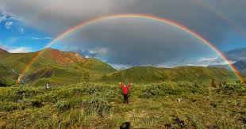
Rainbow W’s
Use this link to learn the tune of the song. ☺
https://www.youtube.com/watch?v=IRU6GtG7BZw
Oh I like WHO?
It’s the characters in the story.
WHAT? It’s what happens in the book!
WHEN? It’s the day or the time or week, month, year.
WHERE? It’s the setting of the story; the place where it happens
And then there’s WHY? It’s the reason for the story; you should use because!
And when you put those W words side by side, now what do you think you’ve done?
You’ve made a rainbow! And it’s a really beautiful one!

Slide 3
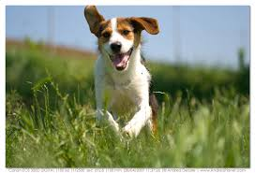
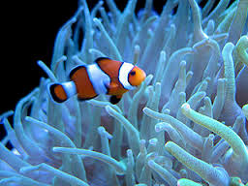
Declarative Sentence
A declarative sentence is easy.
Almost every sentence is one, you see.
So, remember if it’s stating something,
Use a period- it’s declarative.
The dog is running. Or, The fish is swimming.
Easy, boring, using the declarative.
Want to sing along? (tune: Proud Mary)
0:00-0:43

Slide 4
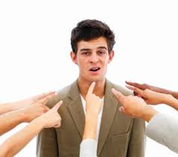
Imperative Sentence
Stop! It’s imperative! That means a command or request.
“You” can be added!
Use a period or exclamation point.
Think it over!
Want to sing along? (Tune: Stop! In the name of love!)
0:53-1:18

Slide 5
Interrogative Sentence
Do you know interrogative?
It’s when you ask a question.
It’s easy to find, ‘cause there’s a question mark.
Can you listen?
Is there a question to answer?
Then you know for sure, it’s interrogative.
Want to sing along? (Tune: Do you Believe in Magic?)
0:00-0:27

Slide 6
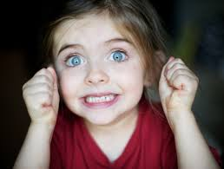
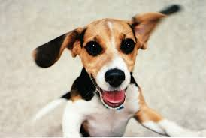
Exclamatory sentence
I’m so excited!
And I just can’t hide it!
I figured out an exclamatory sentence is exciting!
You use an exclamation point
It’s really great!
I know I know I know I know I know I got this!
Want to sing along? (Tune: I’m so Excited)
1:07-1:28

Slide 7
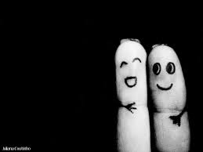
F-R-I-E-N-D
FRIEND!
Tune: F-R-I-E-N-D by Sandi Patty
You are a friend to me!
An F-R-I-E-N-D!
You are a friend to me!
An F-R-I-E-N-D
And every letter tells what you mean to me!
F for fun!
R really terrific!
I it’s important!
E Excellent!
N Nice!
D Delightful!
F-R-I-E-N-D!

Slide 8
B-E-C-A-U-S-E
BECAUSE!
Tune: old Mickey Mouse Song
(start at 0:30)
First comes B, then comes E
C-A-U-S-E
Because (clap clap clap clap)
Because (clap clap clap clap)

Slide 9
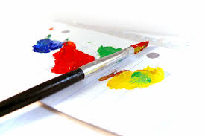
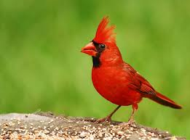
F-A-V-O-R-I-T-E
FAVORITE!
Tune: This Old Man
What is your favorite word?
Favorite color, favorite bird?
F-A-V-O-R-I-T-E
Favorite spelled for you and me!

Slide 10
Bossy R
He’s bossing us.
And we’re just just some little vowels
Bossy R makes such a fuss
And he’s changing our sounds somehow.
And you just gotta know that it drives us insane
How R changes our sounds causes pain in the brain
Now O-R says OR
And A-R says AR
And I-R E-R U-R they say ER because of R.

Slide 11
Two sounds for TH
Teacher says t says /t/ Teacher says h says /h/
Now she’s changing her mind, and it isn’t so fine.
Take a t and an h, put them side by side.
And now they say /th/ and now they say /th/
She said reading was easy, but I think she lied.
Now with has a /th/ and think does too!
I said “Oh brother! I want my mother!”
Now bath has a /th/ and Thursday does too.
Well this isn’t so bad.
So that’s what you do.
It’s in bath and in path and in mother and brother
And in this and in that and in with and in other
T-h says /th/ and t-h says /th/ (3x)
You just look for the t-h clues and you’ll beat the t-h blues!

Slide 12
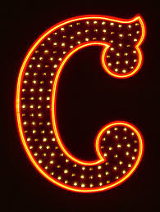
Two Sounds for C
Tune: Waltzing Matilda
(start with chorus, 0:20)
A c has two sounds!
/s/ and /k/ are the sounds
You can sing along with me
/s/ goes before y, I, and e and
/k/ goes before the other letters you’ll see!
December, pencil, bouncy
Cot cup pack act
You can sing along with me
/s/ goes before y, I, and e and
/k/ goes before the other letters you’ll see!

Slide 13
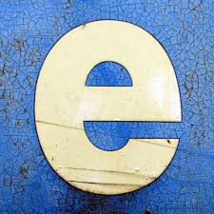
Three sounds for e-d
Tune: Pop Goes the Weasel
There are three sounds for e-d
We’re going to learn them now
So e-d can say /d/ /t/ /ed/
And I’ll show you how!
/d/ is for most words
But /t/ is for the voiceless
When words end in a d or t,
Use /ed/ and no more stress!

Slide 14
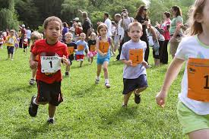
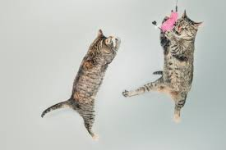
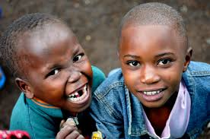
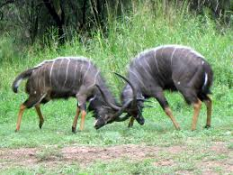
I-N-G
i-n-g says ing!
i-n-g says ing!
Running, jumping, laughing, fighting,
i-n-g says ing!

